Slide 1

CONNECTING WITH HARD TO REACH GROUPS, INTERNSHIP PILOT
Maisie Watling and Olivia Woolley, West Yorkshire Police, Communications Interns

Slide 2
Olivia- University of Leeds (BA Communications and Media) student on a year in industry, returning to studies in September 2022
Maisie- University of Leeds (BA Journalism) graduate 2021, since June has been taking on a part time Communication Officer role alongside working three days a week on the internship
Role Overview:
Drive greater engagement with young and ethnic minority audiences
Changed to be more in line with the national VAWG strategy, more broadly targeting women who might have resistance towards policing and therefore, are a hard to reach group
Identify communications gaps, suggest and implement new ways of working and create a solid base for future activity

Slide 3
Our key findings
1. Focus on what you can change at a communications level by becoming an anti-victim blaming organization
2. Effective Consultation is Early and Open
3. To be engaging, you need to be relatable

Slide 4
1. Focus on what you can change at a communications level by becoming an anti-victim blaming organisation
Our interpretation of victim blaming
How we could see this in the existing external content
Our approach was to do a review of the content and remove or replace any victim blaming attitudes

Slide 5


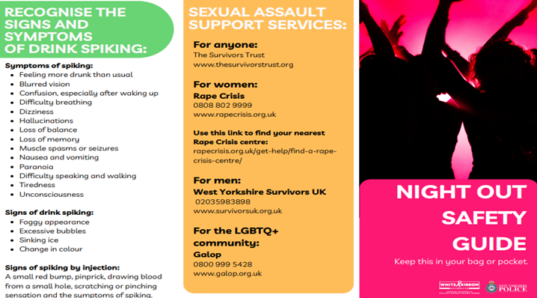

Example 1: Night Time Economy Leaflet
After

Slide 6
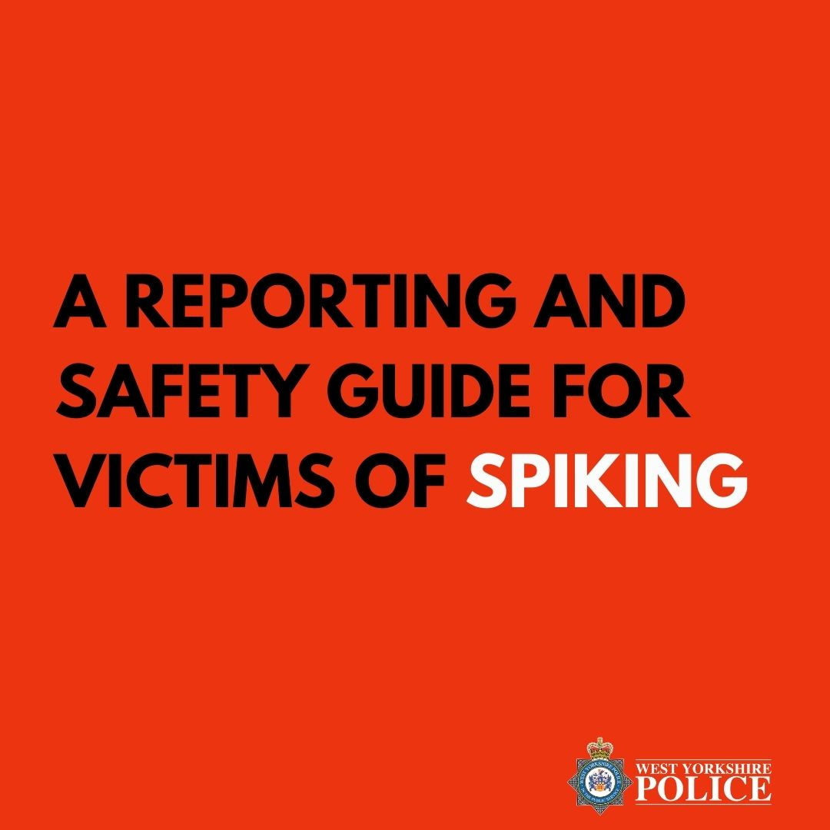
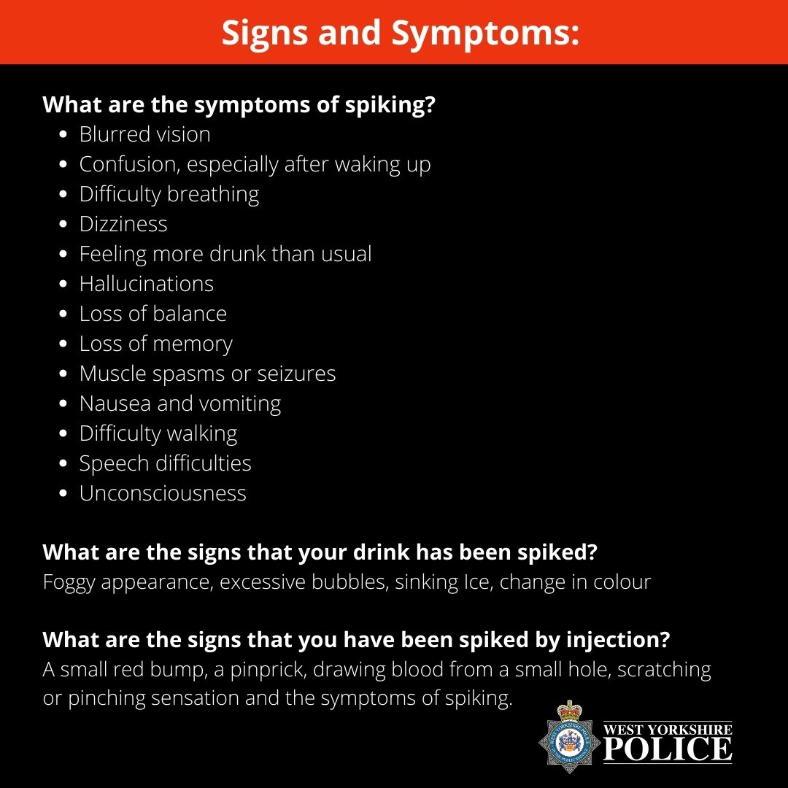
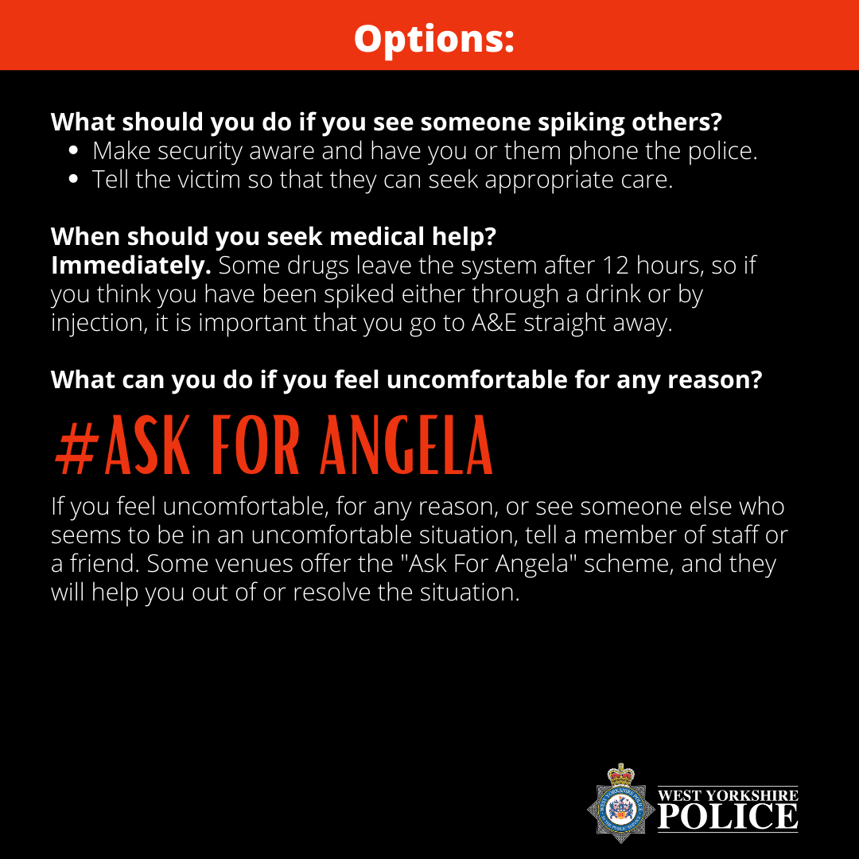
Example 2: Spiking

Slide 7


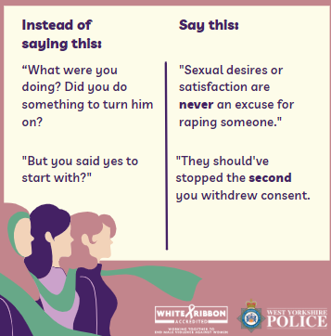
Example 3: Rape Myths

Slide 8
2. Effective Consultation is Early and Open
Start consultation as soon as possible
Make sure that the consultation groups reflect those you are trying to target e.g. Women’s Lives Leeds for VAWG
Early enough to implement the considerations and have the willingness to do so

Slide 9



Moving away from old victim blaming attitudes through validating consultation group's opinions and working actively and promptly to adapt materials
“I can definitely see the feedback incorporated….looking forward to further collaborative working in the future… I've not seen a case of feedback being really listened to and incorporated like it has been…this is the sort of thing I think will help women have that increased trust and confidence, as the aim states."
Example 1: VAWG Launch

Slide 10

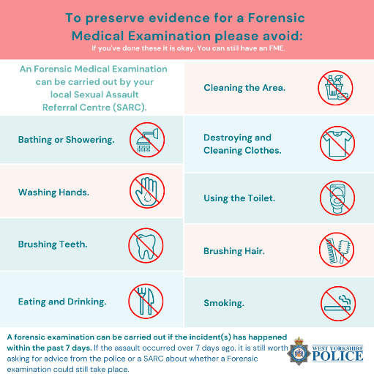
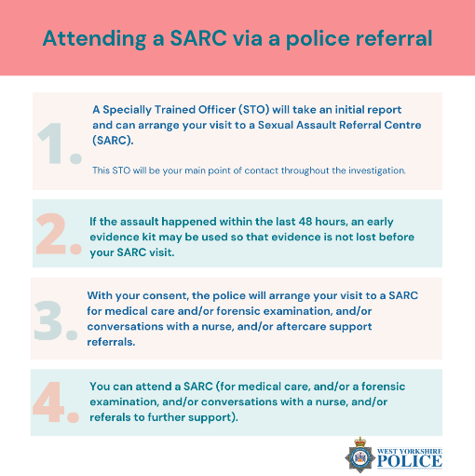
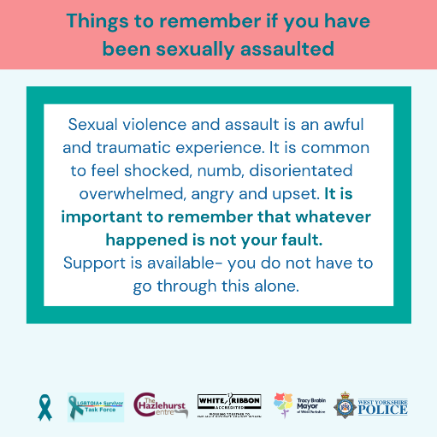
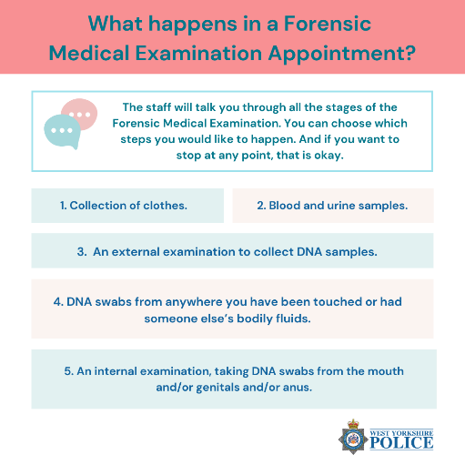
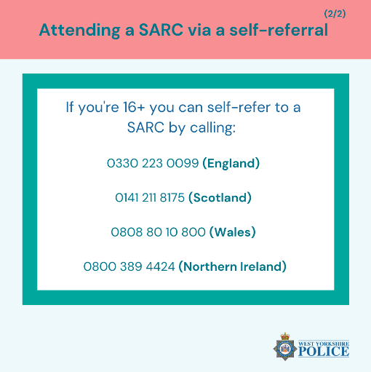
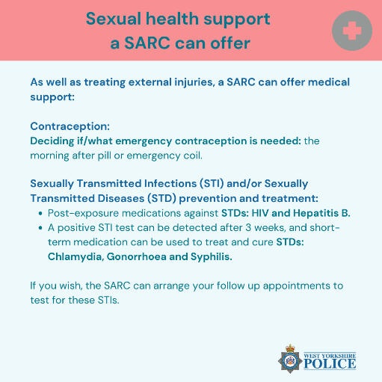

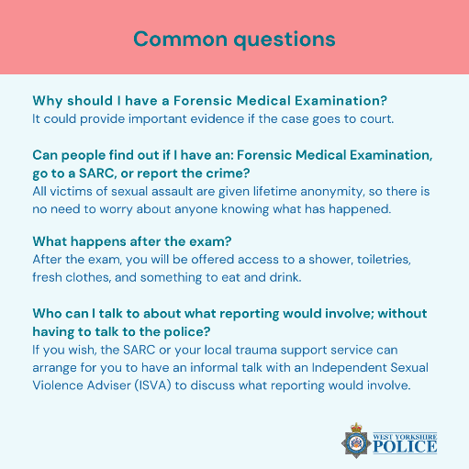

Example 2: SARC Post

Slide 11
3. To be engaging, you need to be relatable
Give examples of how crimes can present
Stock images do not equal personalisation of policing messaging- representations of distressed victims and survivors often disempower
Contingency plan and monitor the rise of online movements

Slide 12
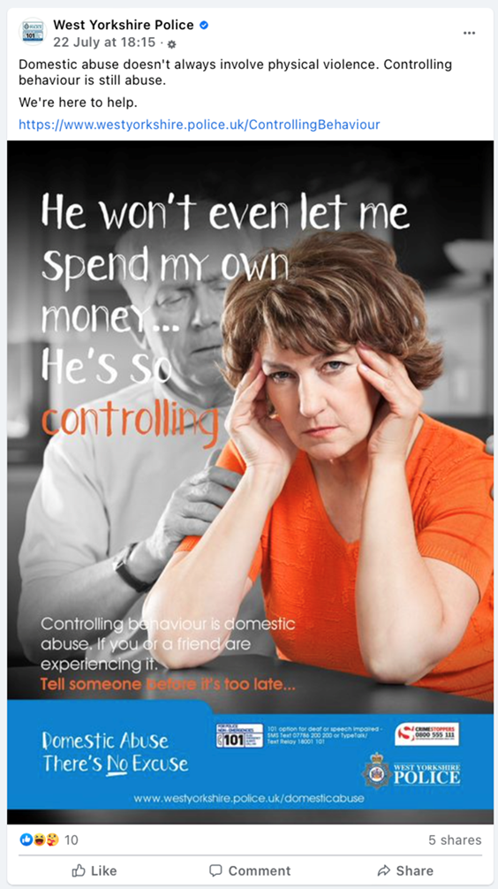
Before, domestic abuse: Valentine’s Day Post

Slide 13






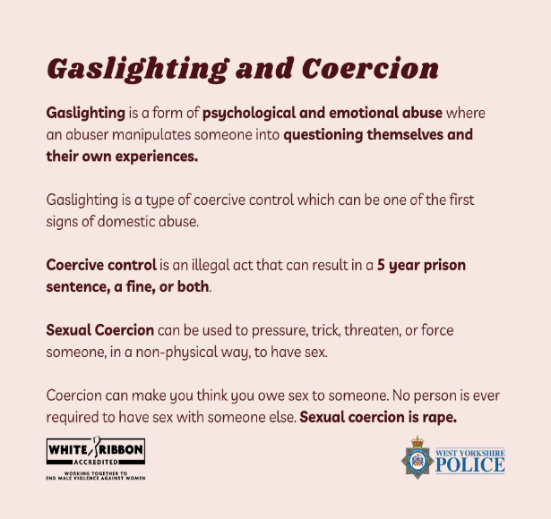

Example 1: Valentine’s Day Post

Slide 14

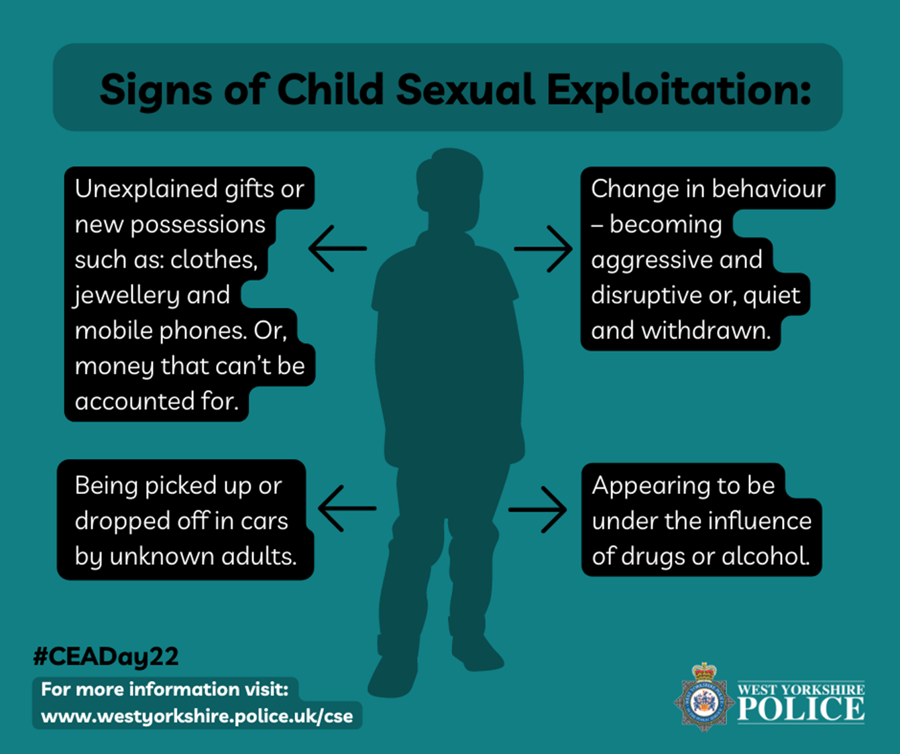

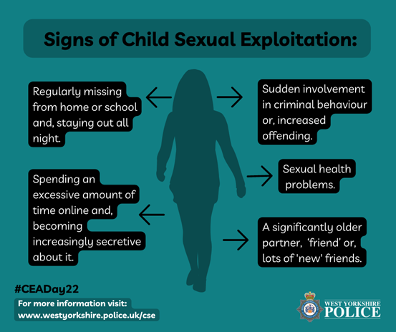

Example 2:
Child Sexual
Exploitation

Slide 15



Example 2: Forced Marriage

Slide 16

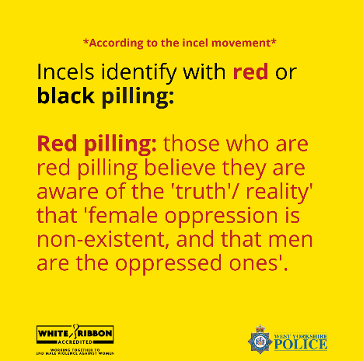
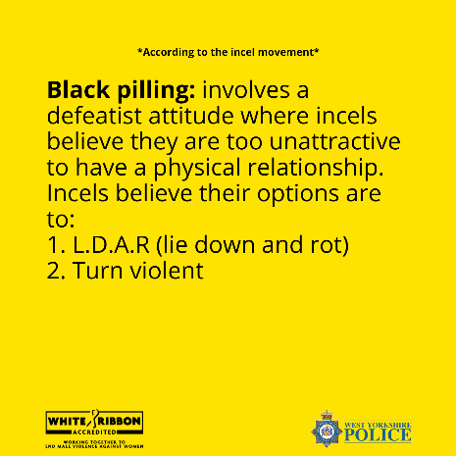


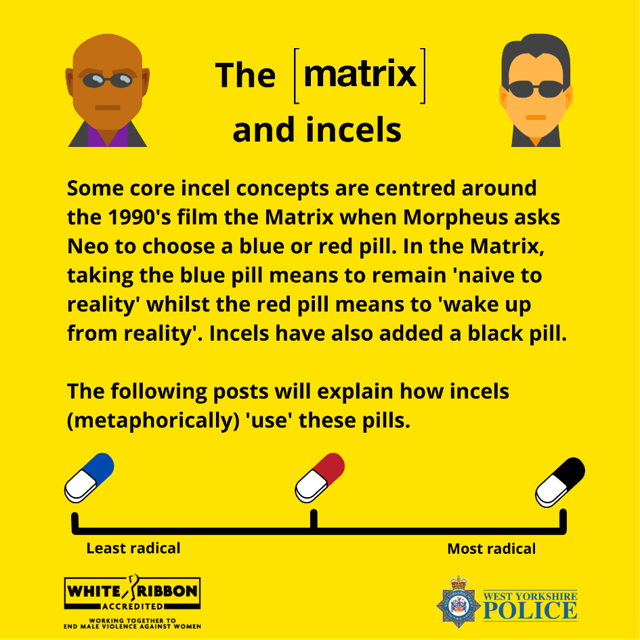

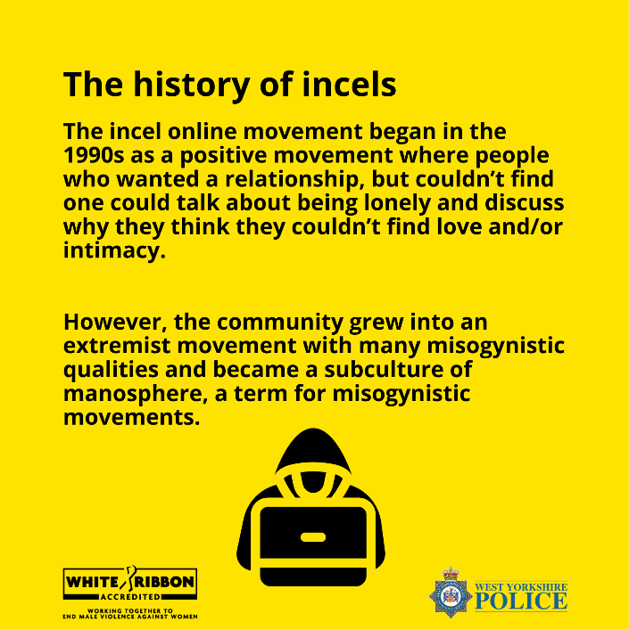
Example 3: Incels

Slide 17
Implications
The focus on reaching ethnic minority groups was somewhat lost due to alignment with the national pressure of addressing VAWG within police communications.
Questions remain on the best methods for reaching ethnic minorities, and this is something we are still keen to develop.
Measurability of success for the new approaches that the interns have introduced, as the short-term evidence is merely the engagement statistics from social media.

Slide 18

Final Comments
Nigel Swift, Head of Corporate Communications WYP
West Yorkshire Police Chief Officer Team has received this pilot very positively, agreeing to a further year two interns intake for 2022/23.

Slide 19
Any Questions

